Slide 1

IPL Data Analysis
Md Amjad Ansari

Slide 2




Agenda
Introduction
Scope of Analysis
Source of dataset
ETL Process
Analysis on Dataset
List of Analysis with results

Slide 3



Introduction
Data analysis in Tableau is a powerful and widely used method for examining and making sense of data. Tableau provides a range of tools and functions that can help us manipulate, visualize, and draw insights from the data. Here's an introduction to data analysis in Tableau:

Slide 4


Introduction:
Data Input
Sorting and Filtering
Data Visualization
Pivot Tables
Data Cleaning
What if Analysis

Slide 5
Scope of Analysis:
Objective
Team Performance Analysis.
Venue Analysis.
Player performance analysis.
Data Collection.
Data preprocessing.
Statistical analysis.
Performance prediction.
The objective and scope of analyzing an IPL dataset can vary depending on your specific goals and interests. This project on Indian Premier League (IPL) Statistics of India provides the overall Statistics details of the matches of IPL and teams progress in various aspects from the year 2008 to 2023.

Slide 6
Source of Dataset:
IPL (Indian Premier League) datasets can be obtained from various sources, including official IPL websites, data providers, and cricket statistics databases.
Insights of Data:
Season, Date, Stadium, City, Win by runs, Win by wickets, player of the match etc.

Slide 7
ETL Process
Extract:
Data extraction
Transform:
Data transformation
Data cleaning
Data Validation
Data mapping
Load:
Data Loading
ETL stands for Extract, Transform, Load, and it refers to a process used in data integration and data warehousing. The ETL process is essential for collecting, cleaning, and preparing data from various sources for storage or analysis.

Slide 8
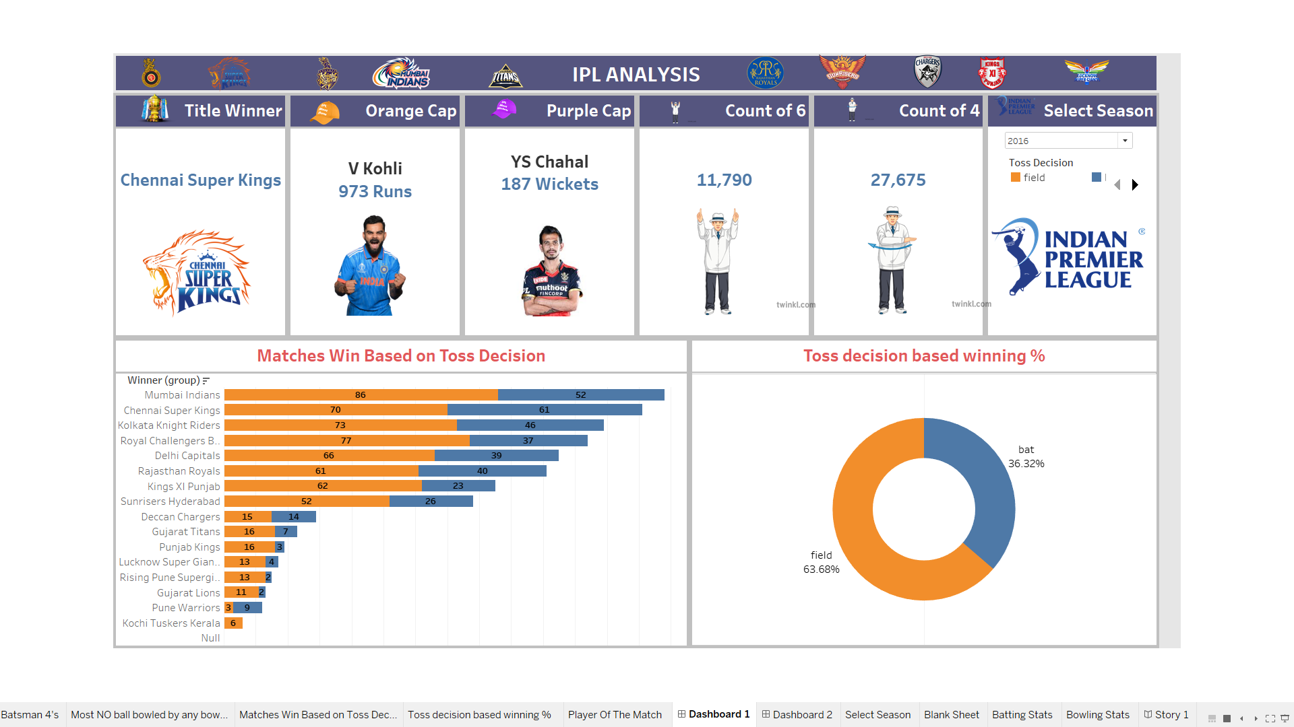
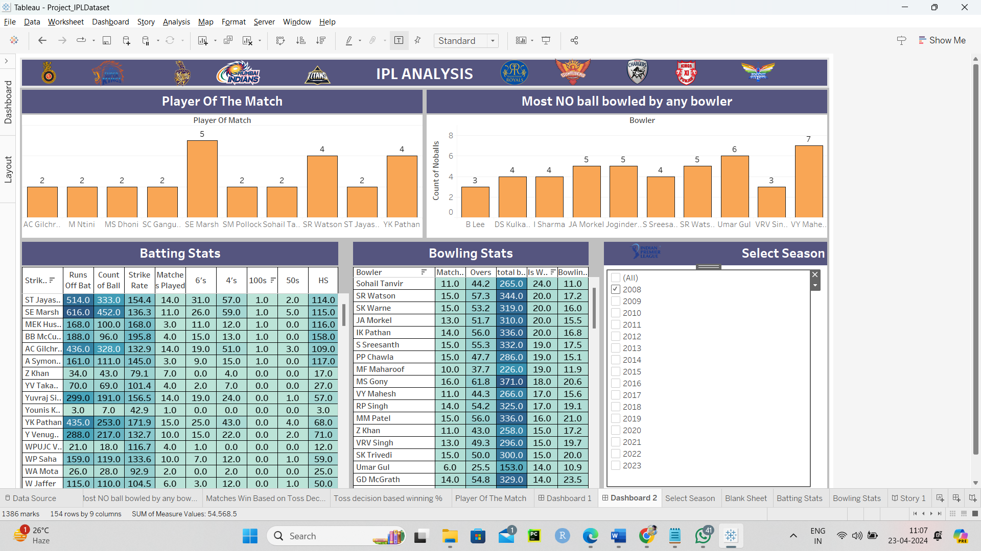
Analysis on Dataset:

Slide 9

Thank you
Md Amjad Ansari
amjadaaa00786@gmail.com

